Slide 1
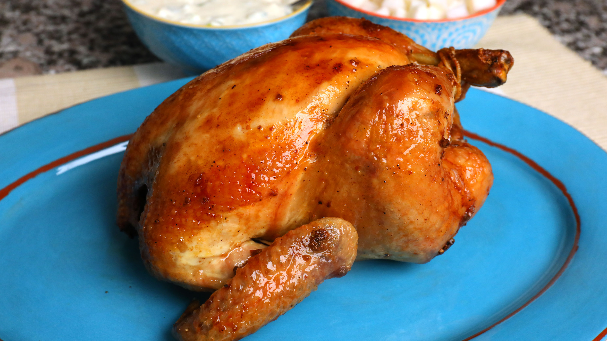

I.T.F (Is This Food)
Michael Dang, Richard Gesin, Benjamin Chrisman

Slide 2
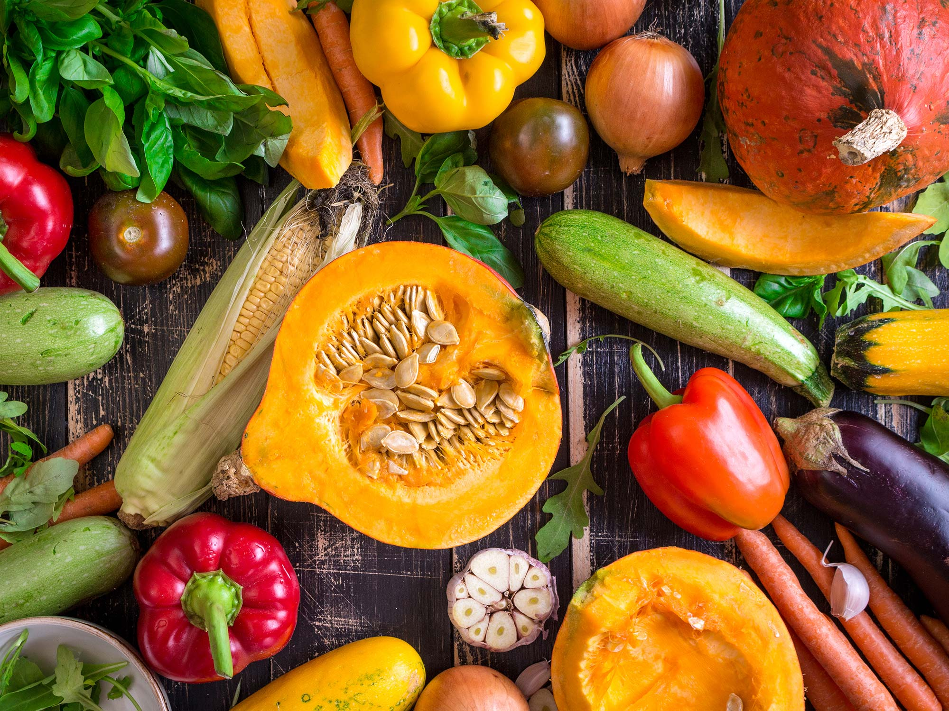
Why do you want to use our App?
Client Description
User Interface
Our application has a simple UI that will leave the user confused
Image Selector
User can browse images previously taken from the camera within the app, or within the phone’s gallery.
Camera Controller
The camera can be opened and controlled through the app, no need to open a seperate camera application.

Slide 3
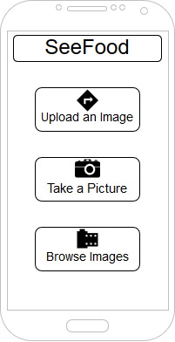
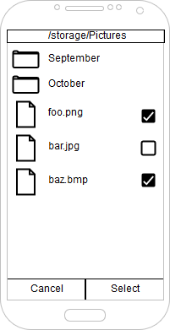
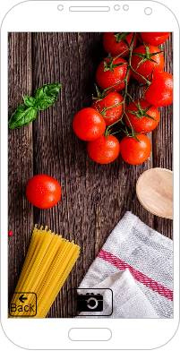
Screenshots

Slide 4
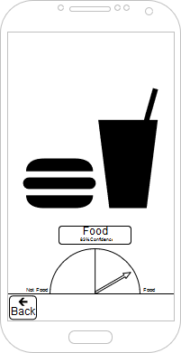
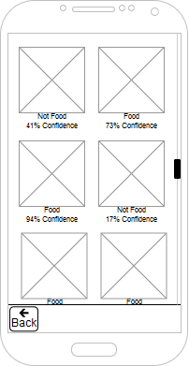
Screenshots Cont.

Slide 5
Milestones
Connected to EC2 server
Common functionality reached
Take picture
Upload picture and receive feedback
Browse images
Images stored in directory

Slide 6
Future Updates
Polish User Interface
Image thumbnails when selecting an image
Debug the application
Add tutorial or FAQ page

